Slide 1
Inventory Management System
ATRI Banerjee (B-72), SOUBHADRA Bhattacharya (B-71), GOPESH Sharma (B-70)

Slide 2
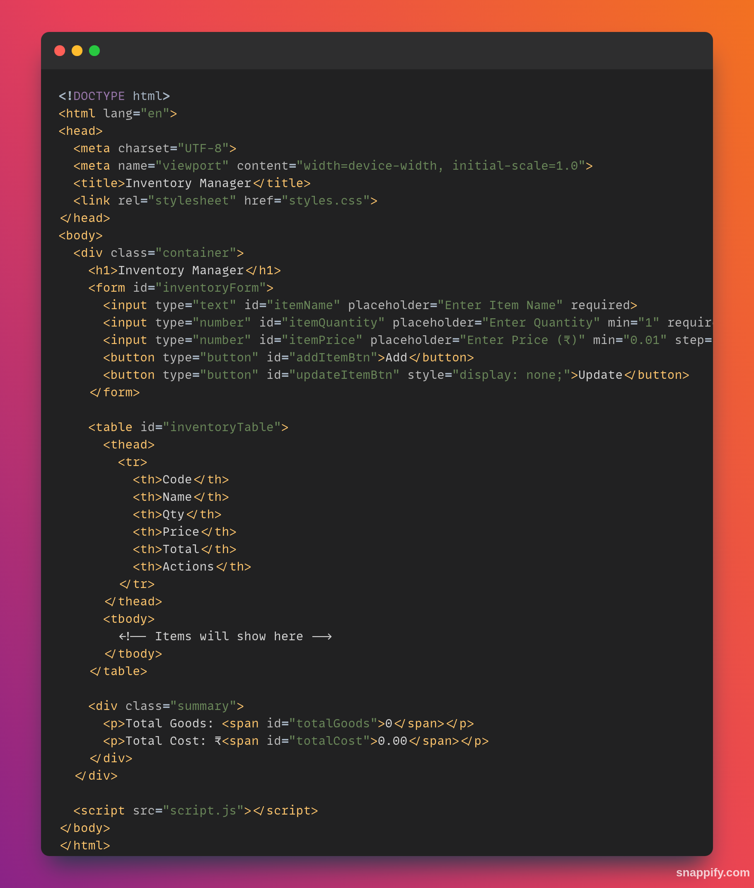
INTRODUCTION
An inventory management system is a software solution designed to streamline the tracking, monitoring, and control of items across various categories. It enhances operational efficiency by doing tasks such as adding an item, calculating total price and keeping track of the inventory , ensuring optimal inventory levels while minimizing costs.

Slide 3
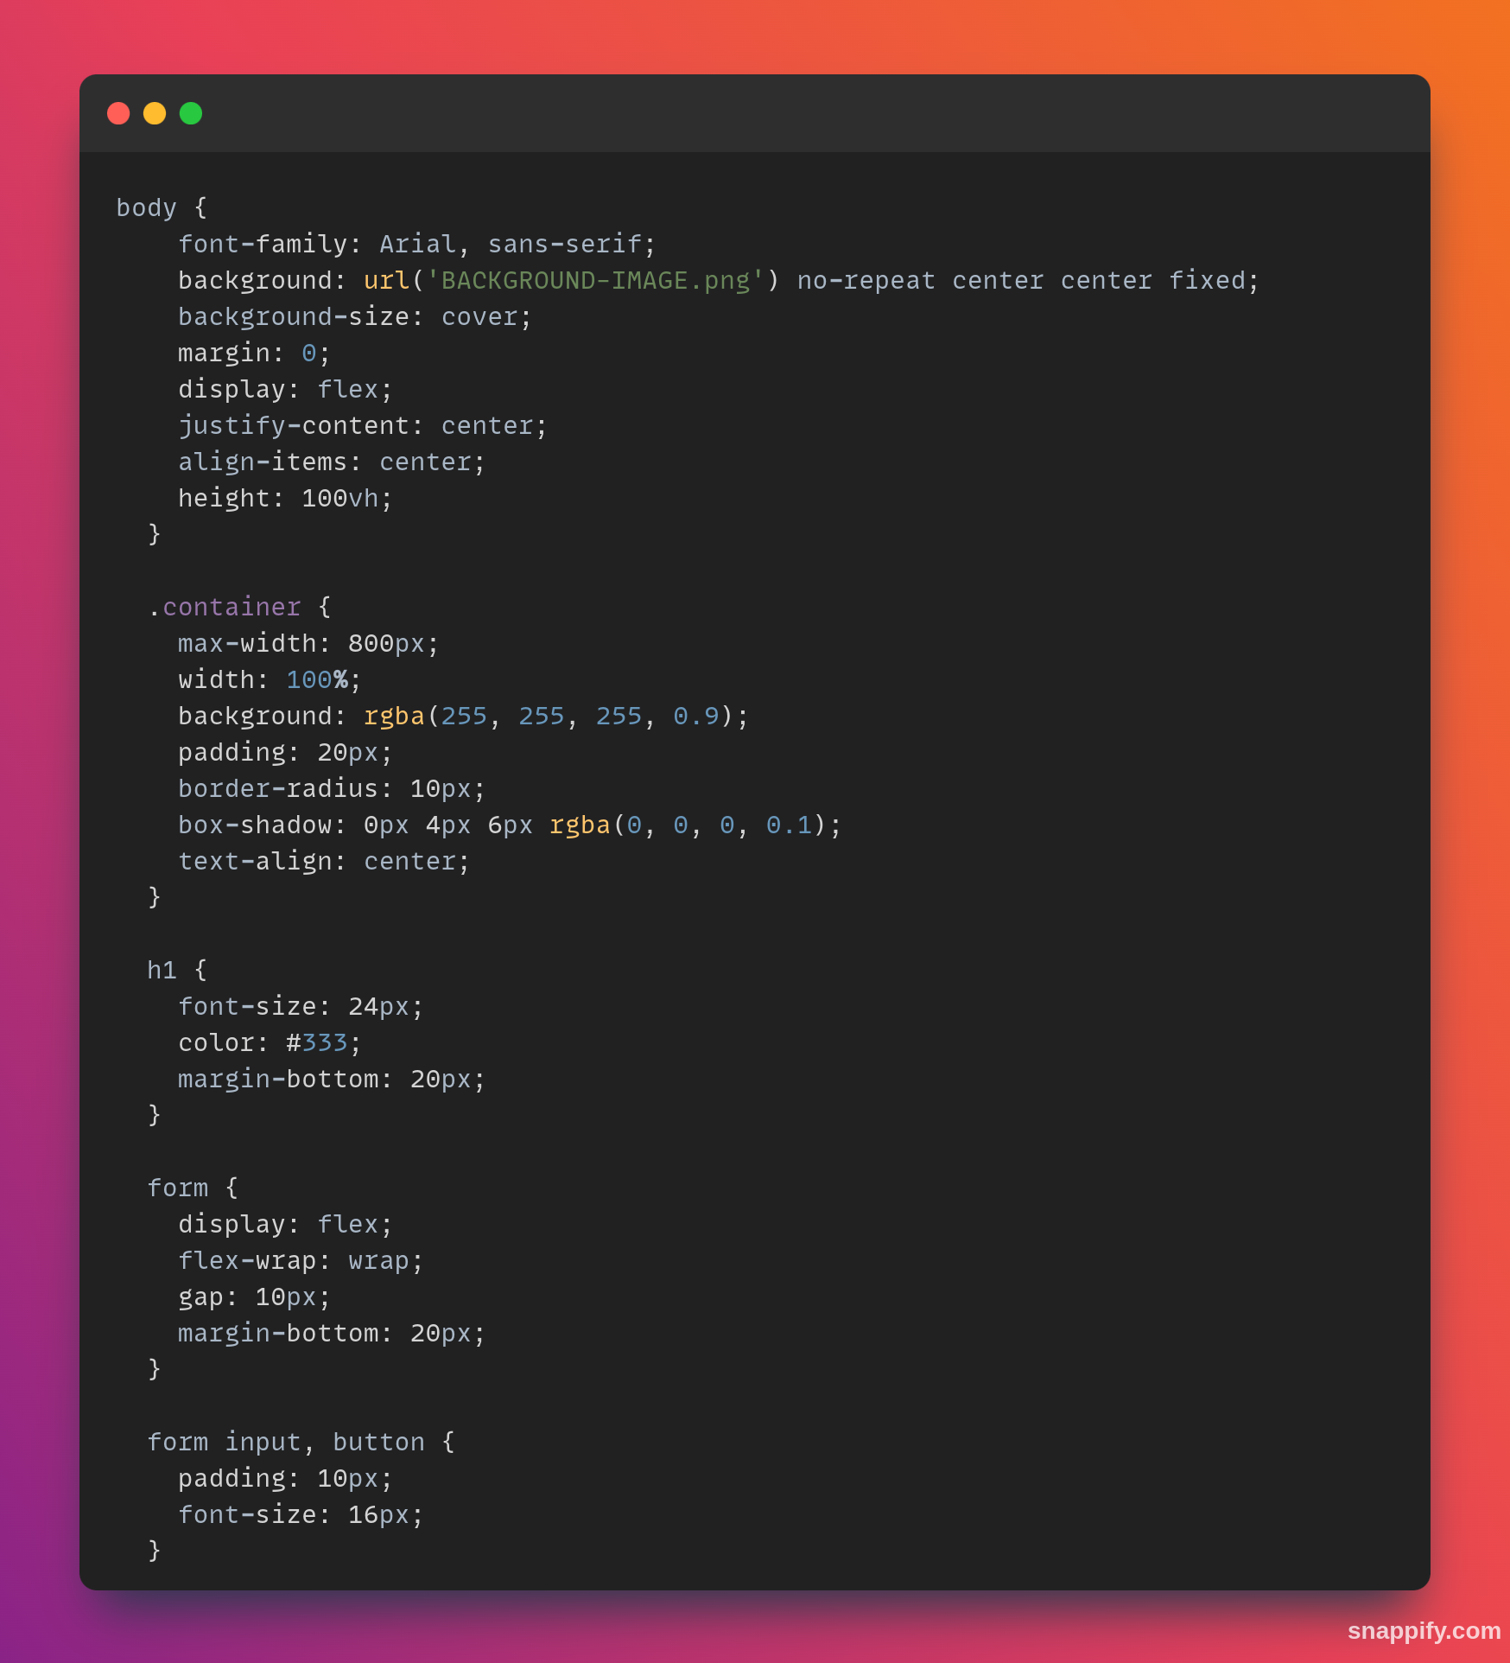


OBJECTIVES
- Minimize inventory holding costs and waste.
- Improve accuracy in tracking and reporting inventory.
Categorise items for better management
- Streamline replenishment and order fulfillment processes.

Slide 4
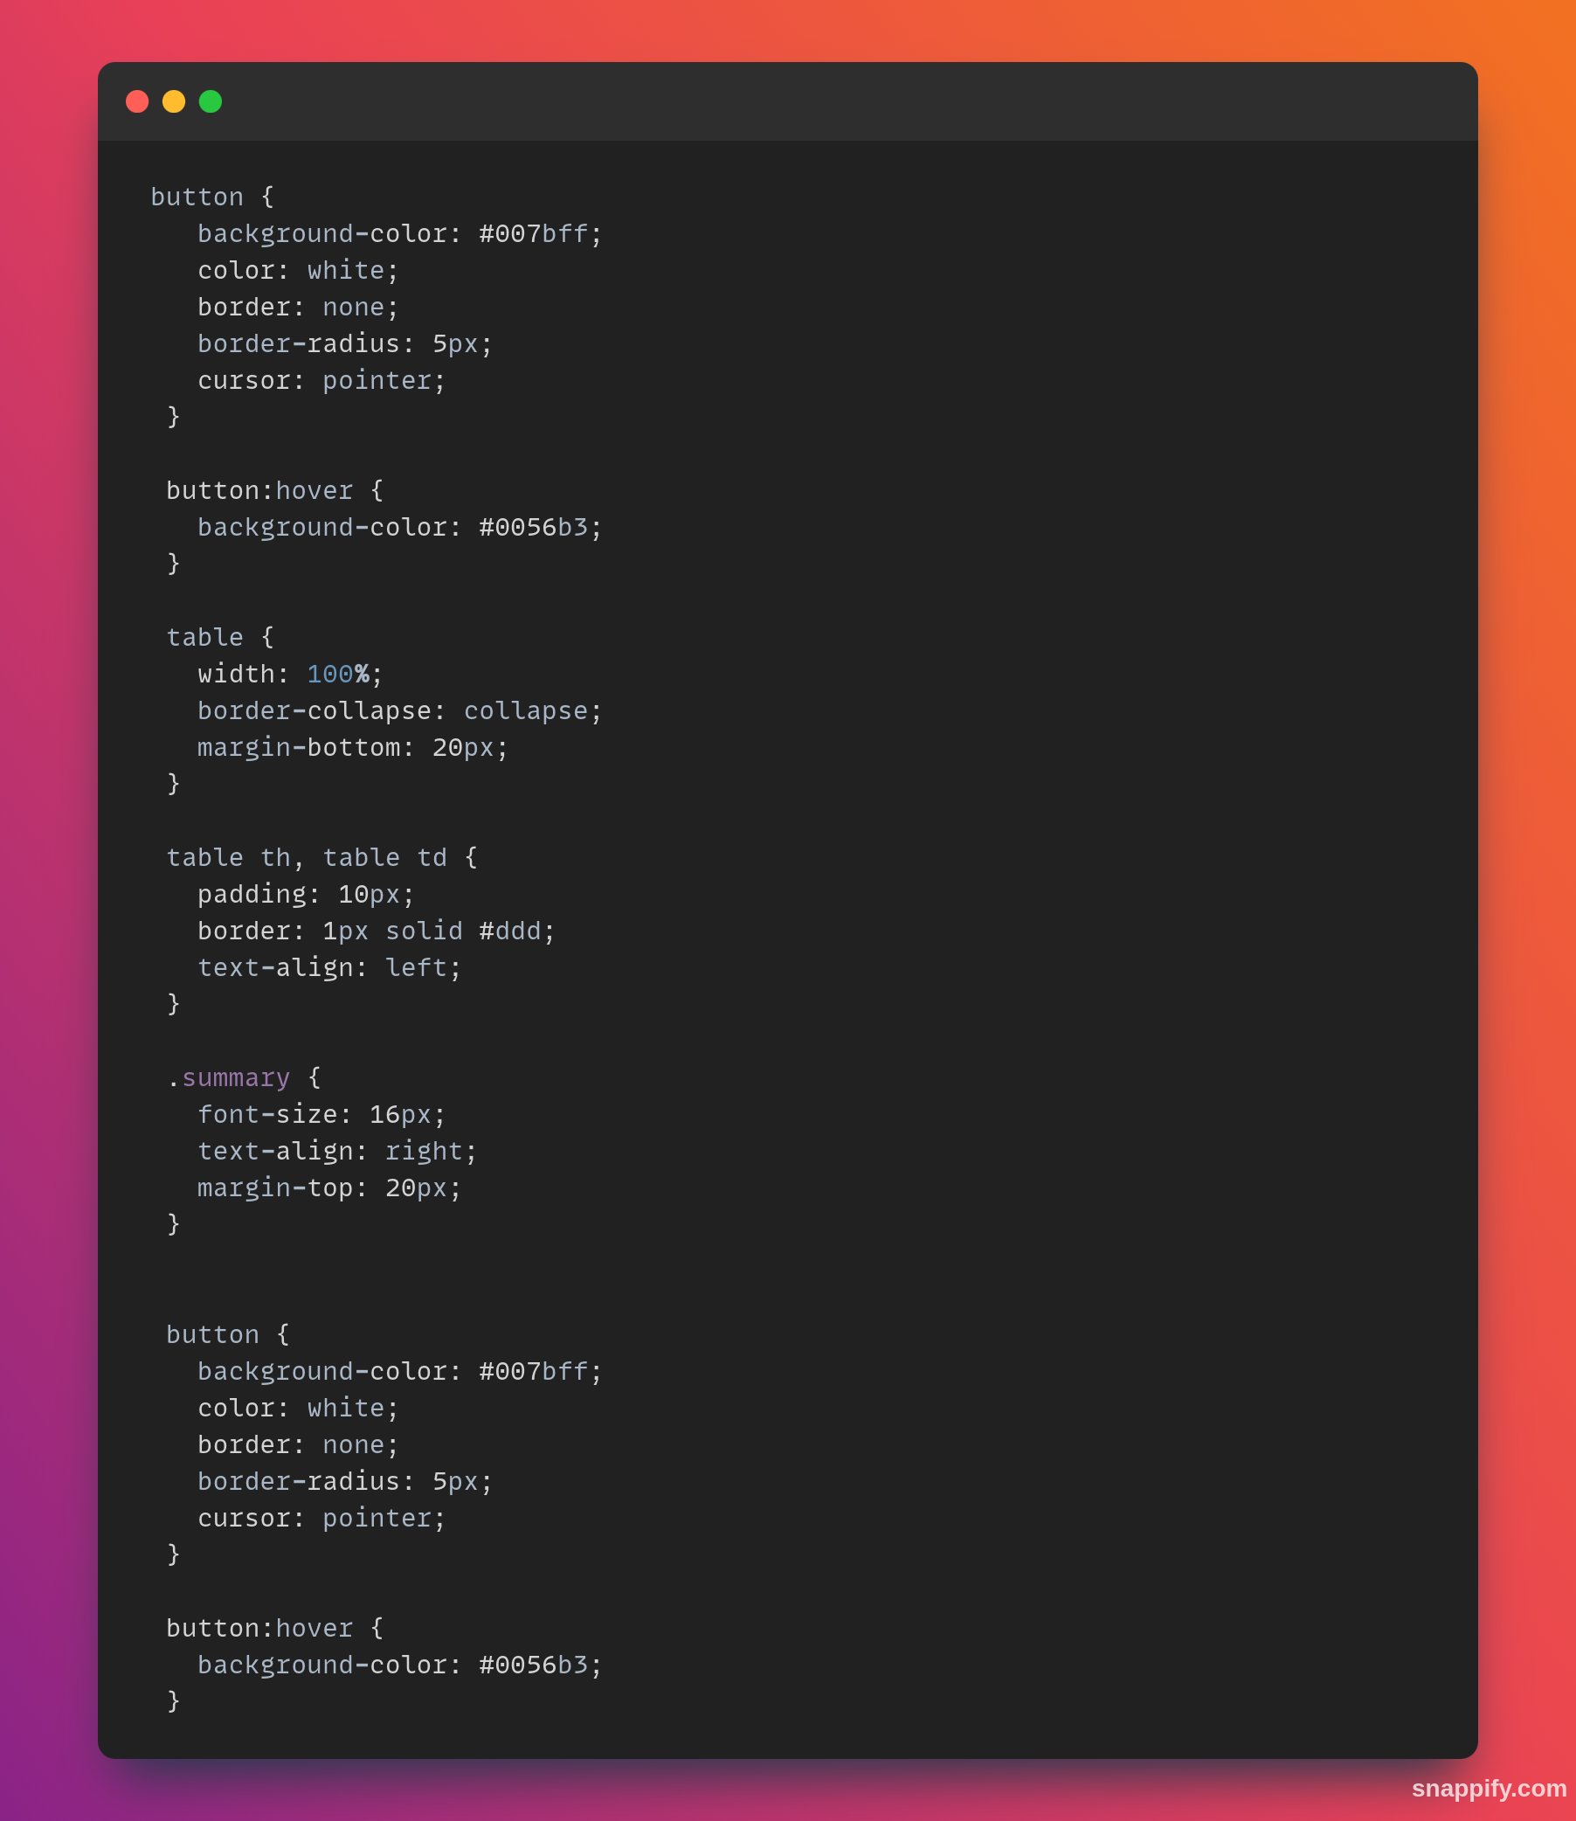
KEY FEATURES
Inventory tracking and updates in real time.
Reduces errors and improves operational efficiency.
Aesthitically pleasing background for view factor
Uses an easy to use ui for easy useability

Slide 5
BENEFITS
- Enhances inventory accuracy and reduces stock discrepancies.
- Minimizes costs by keeping track of items
- Streamlines operations with user input processes and insights.

Slide 6
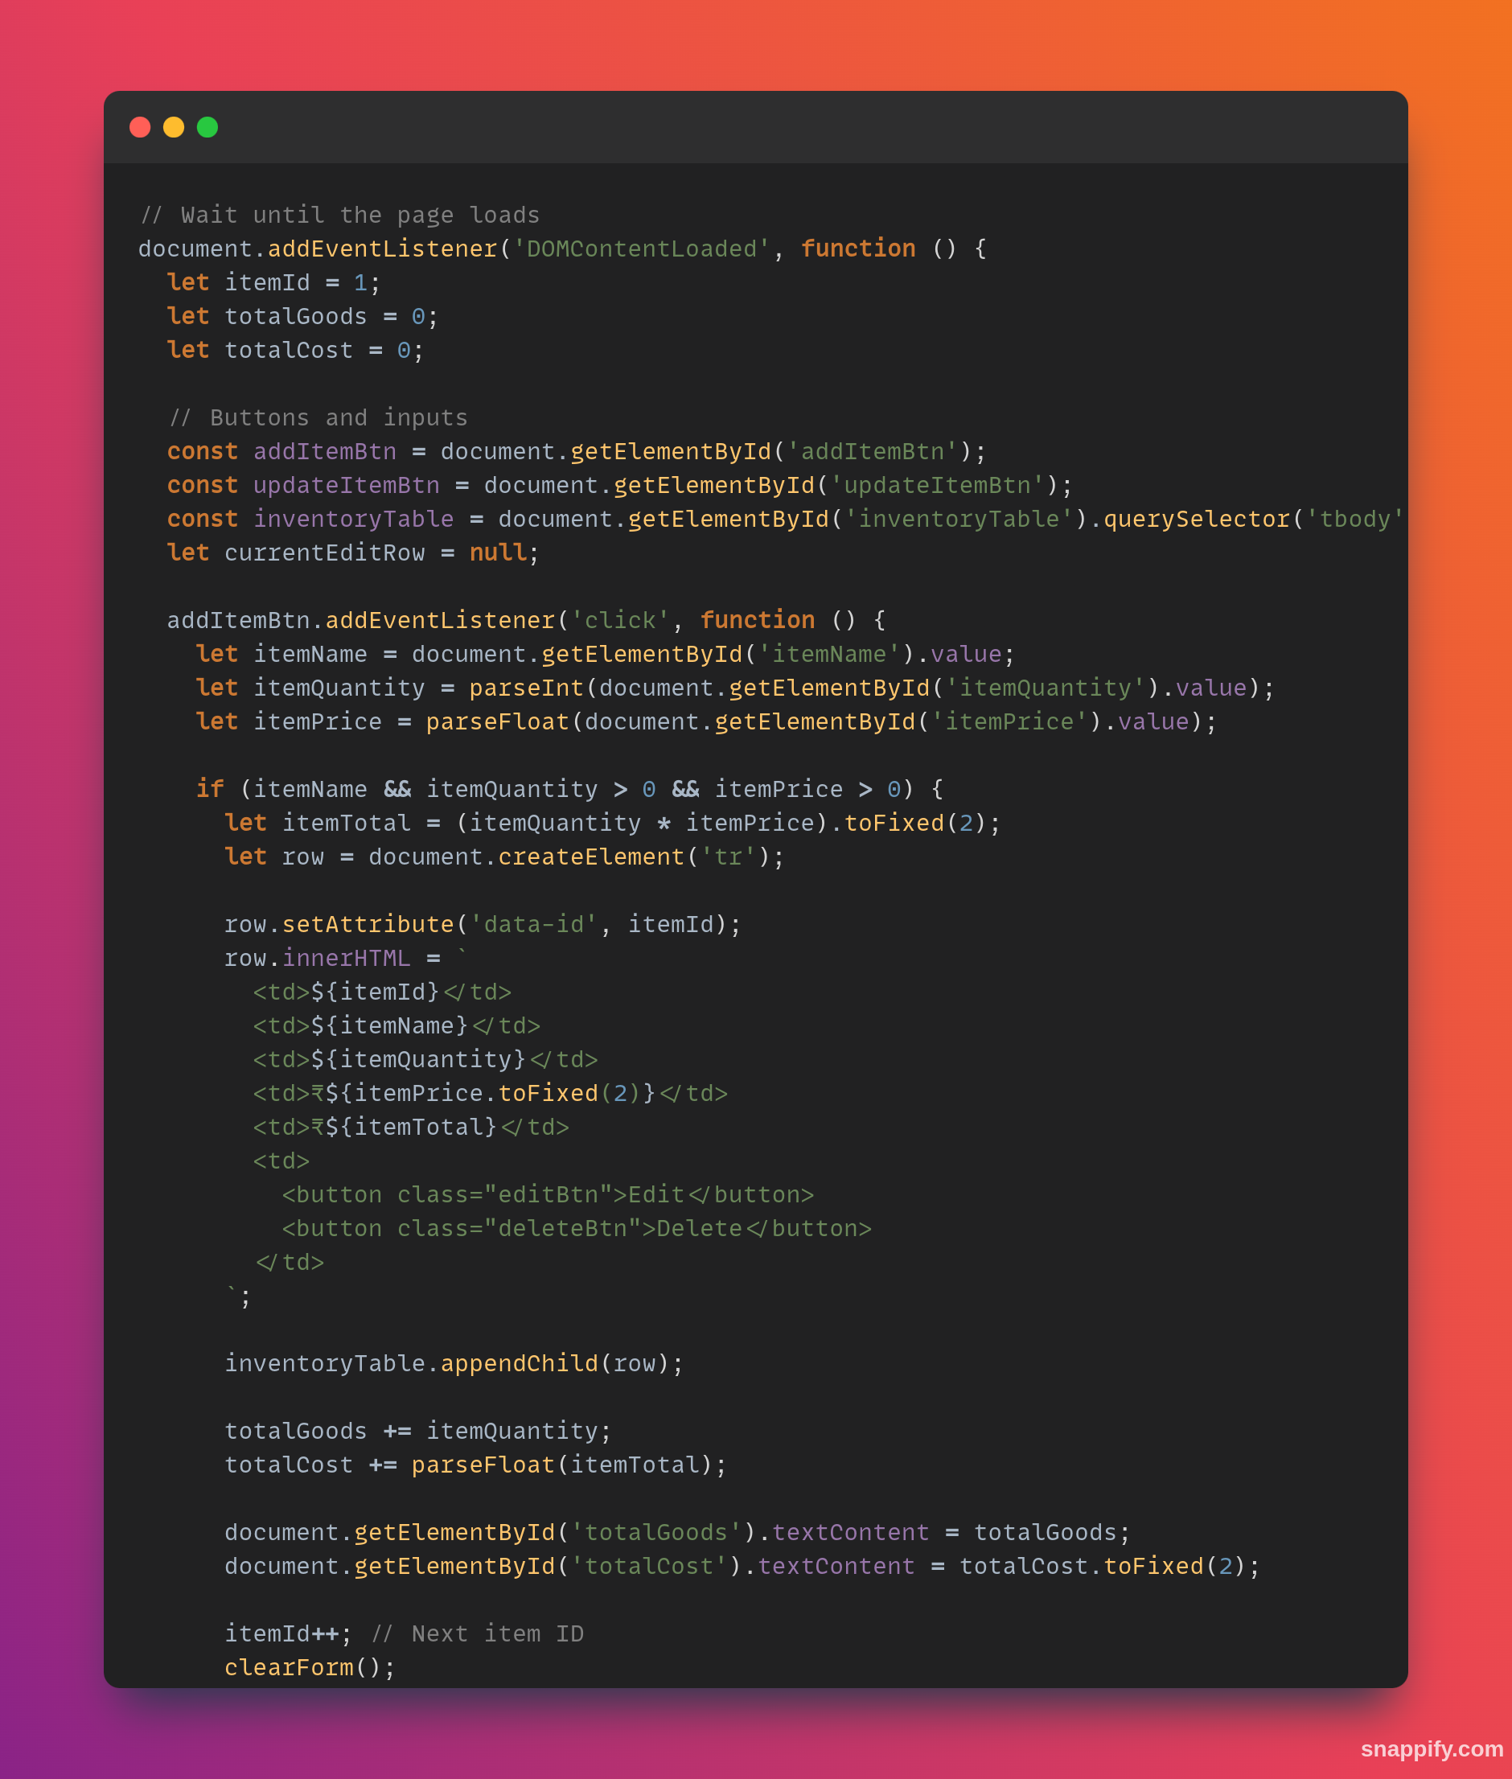
WORKFLOW
- Inventory Input: Record and update items upon receipt.
- Tracking: Monitor inventory movements in real time.
- Reporting: Generate insights on inventory performance.
Discount: It can directly apply discount to the total sum

Slide 7
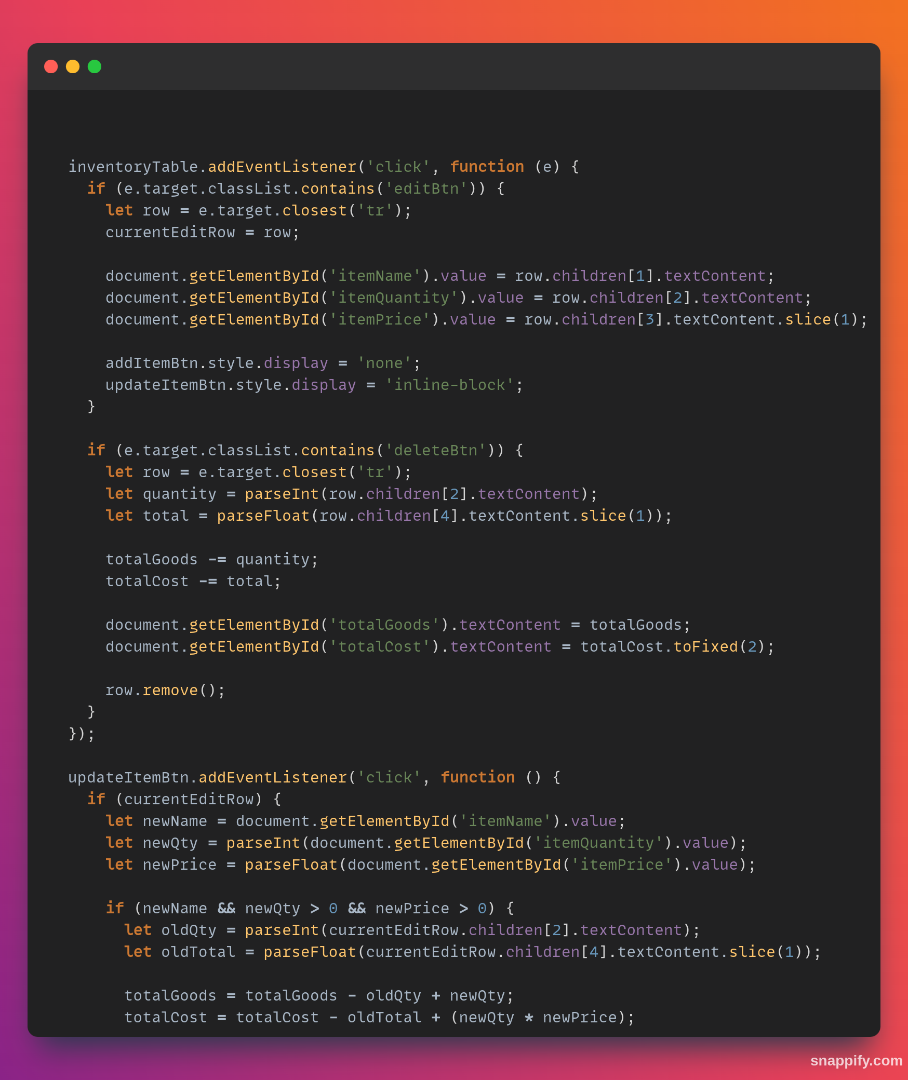
SYSTEM ARCHITECTURE
- Frontend: User interface for attendance check-in/out. Implemented using HTML, CSS and JS

Slide 8
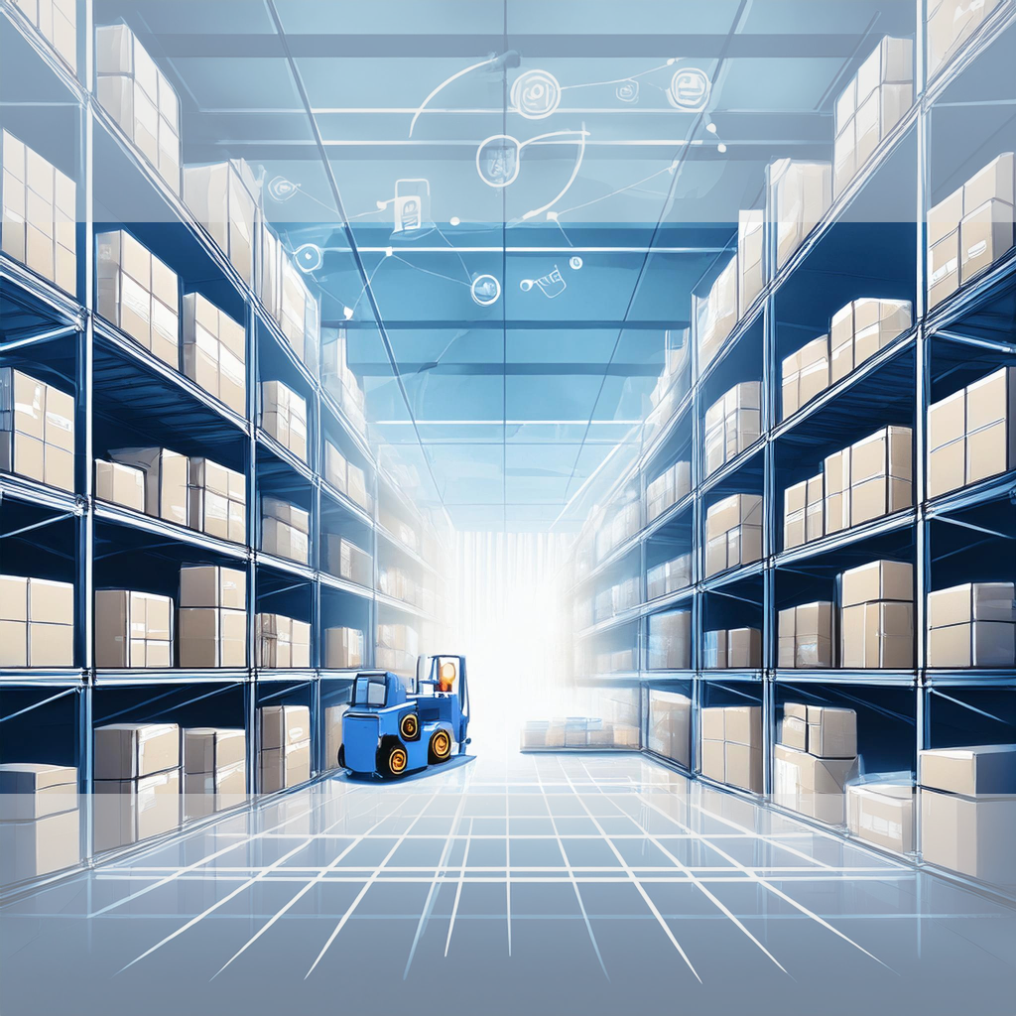
ANALYSIS
REPORTS: Track current inventory levels, aging stock, and product performance.
REPLENISHMENT Reports: Provide insights into reorder points and purchase orders to maintain optimal inventory.
COST ANALYSIS: Evaluate inventory holding costs, transportation costs, and overall profitability. CATEGORY & DISCOUNT SYSTEM: Categorise different items in different categories for keeping track easily also added discount option for better calculation

Slide 9
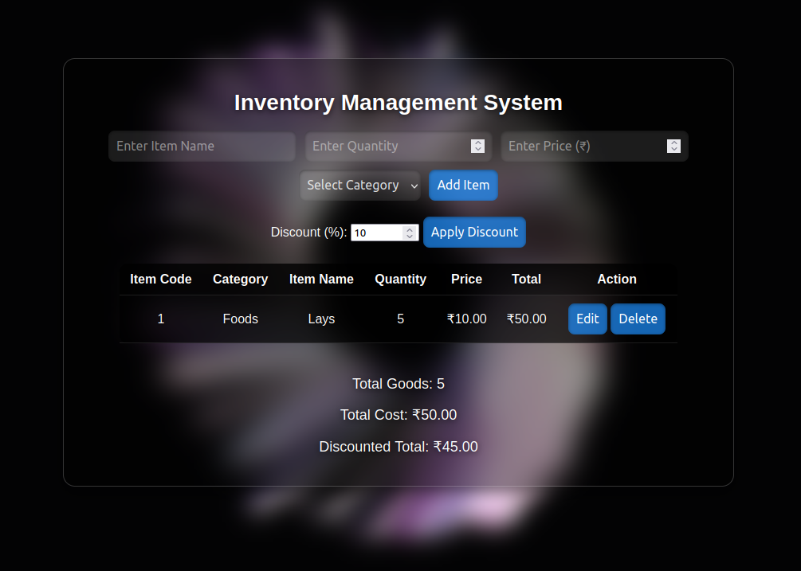
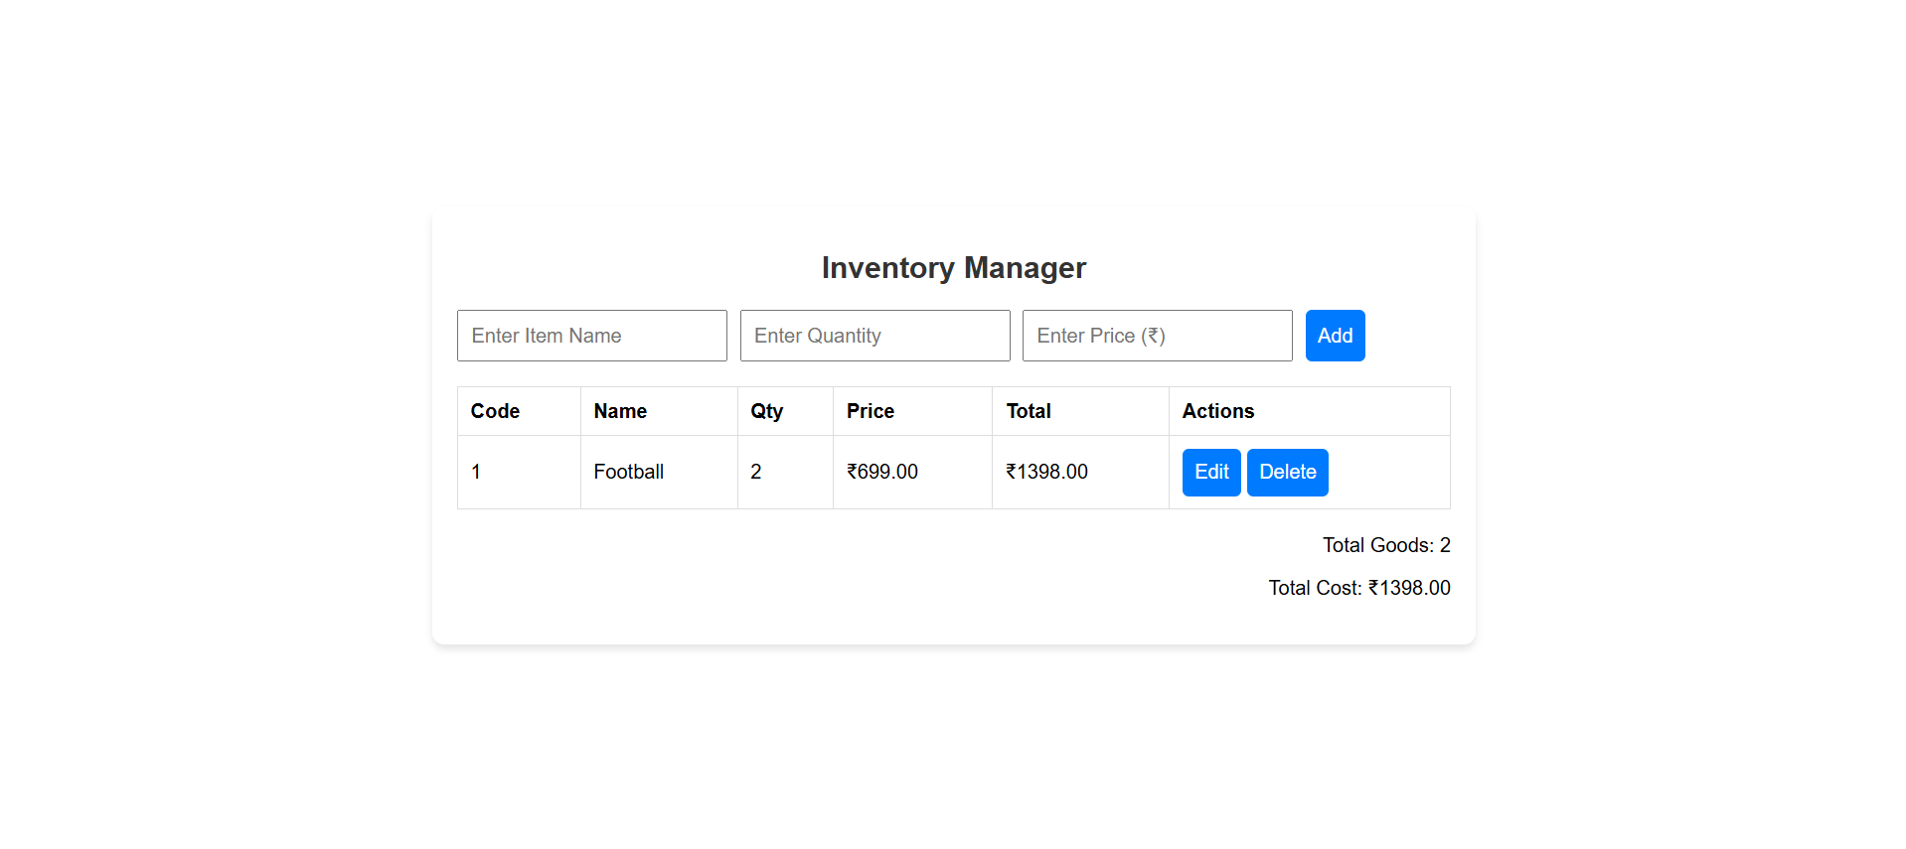
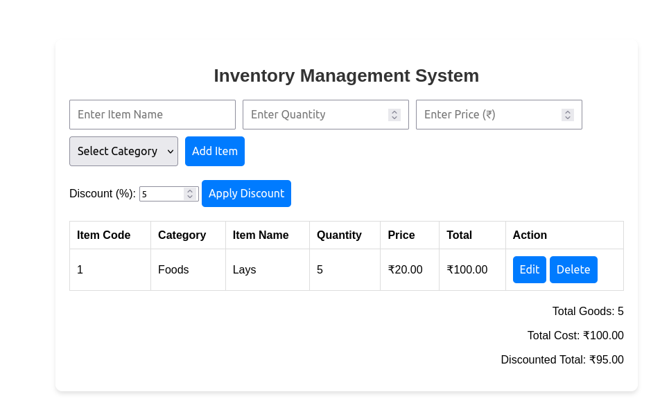
DEMO
Here’s what our system looks like

Slide 10

FUTURE ENHANCEMENTS
Future enhancements may include:
- IoT Integration: Real-time inventory tracking.
- Blockchain: Secure supply chain transparency.
- Mobile Apps: Enhanced on-the-go management.
- Cloud Collaboration: Multi-location real-time access.
- Automated Replenishment: AI-driven ordering.

Slide 11
THE END

